Slide 1

CampusCare
Campus Issue Reporting & Tracking System

Slide 2

Team Members
Name | Roll Number
Sd. Esha Parwaz | 24KB1A05KH
B. Sai Hima Bindu | 24KB1A0563
Sk. Ahadiya | 24KB1A05GZ
Y. Bhuvaneswari | 24KB1A05PB
P. Ruchika | 24KB1A05EL

Slide 3

Problem & Objective
Today
Complaints on paper or word of mouth
No ticket, so no way to track progress
Faculty have no single place to manage them
With CampusCare
One portal to report and track issues
Department-wise handling by faculty
Full status history for every ticket

Slide 4

Key Features
Secure login
Student and Faculty accounts, passwords stored with bcrypt
Raise complaints
6 categories, location, priority and department
Unique ticket ID
Every complaint gets a CAMP-YYYY ticket number
Live tracking
Look up any ticket and see its full status timeline
Faculty dashboard
Department-wise complaints, update status with a remark
Complaint history
Every change logged with who updated it and when

Slide 5
Modules
Student module
Faculty module
Register and log in
Submit a complaint: title, category, location, description, priority
See your own complaints and their status
Track any complaint by ticket ID
Log in and see your department's complaints
Move a complaint to In Progress or Resolved
Add a remark the student can read
Every update is saved in history
Categories: Computer/IT · Electrical · Plumbing · Classroom Equipment · Cleanliness · Other
Departments: CSE · ECE · EEE · Mechanical · Civil · General Maintenance

Slide 6
System Architecture
Frontend
React.js
Backend
Node.js + Express
Database
MySQL
Login, dashboard, forms, tracking page
REST API, validation, bcrypt, CORS
users, complaints, complaint_history
JSON over HTTP (port 5000) → SQL queries through a mysql2 connection pool

Slide 7
Technology Stack
Frontend
React.js (Hooks) · CSS3 · Fetch API
Backend
Node.js · Express.js · bcryptjs · CORS
Database
MySQL · mysql2 (promise pool) · Transactions

Slide 8
How It Works
Submitted
In Progress
Resolved
Student raises a complaint and gets a ticket ID
Faculty of that department reviews it and adds a remark
Student tracks the final status and history
Every status change is saved in complaint_history: the remark, who updated it, and when.

Slide 9
Database & REST APIs
Database tables
users
role, department, hashed password
complaints
ticket ID, category, priority, status
complaint_history
status, remark, updated by, time
Method | Endpoint | Purpose
POST | /api/register | Create account
POST | /api/login | Authenticate user
GET | /api/complaints | List by user / dept
POST | /api/complaints | Submit complaint
GET | /api/complaints/:ticketId | Track one ticket
PUT | /api/complaints/:ticketId | Update status

Slide 10
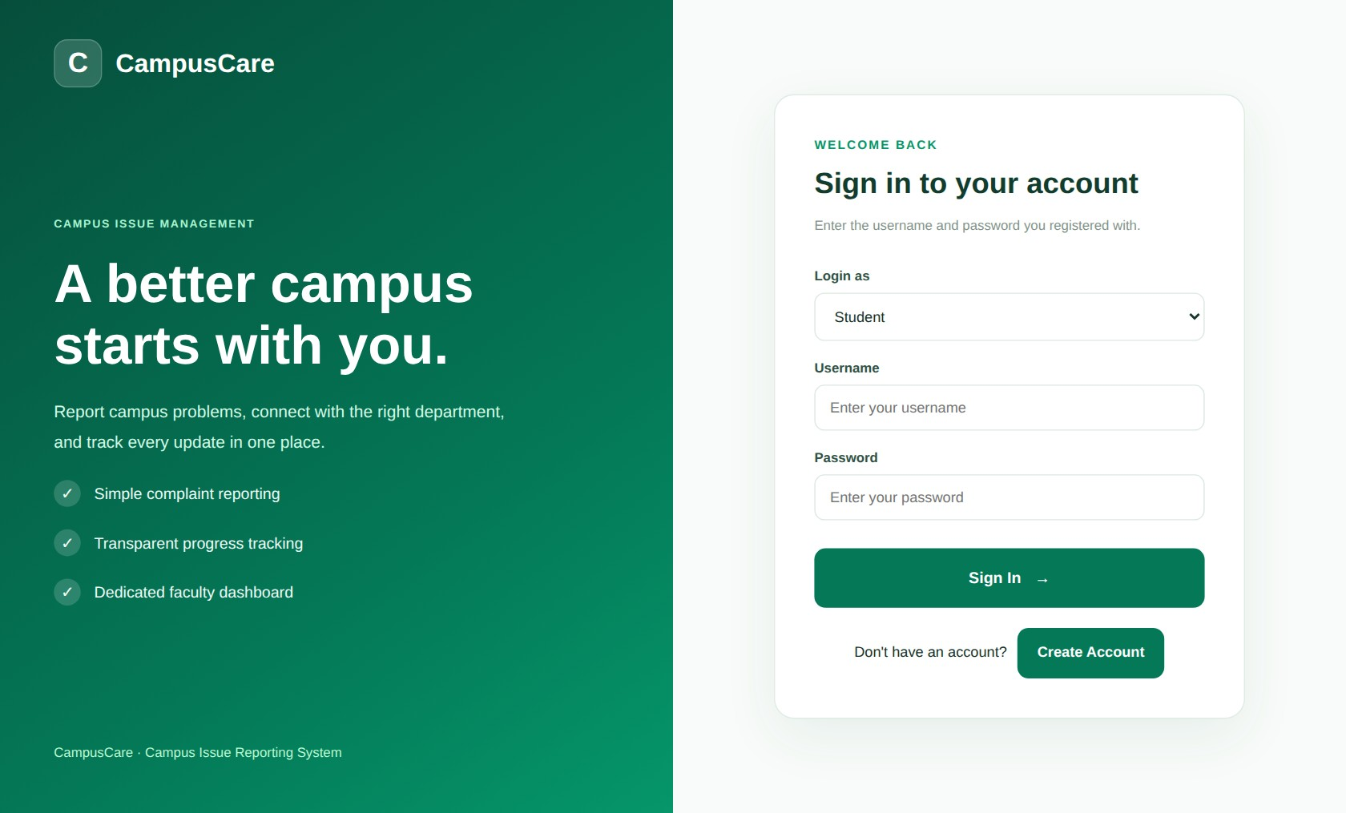
Login & Registration
WHAT IT DOES
Sign in as Student or Faculty
Create an account with your department
Passwords are stored hashed (bcrypt)

Slide 11
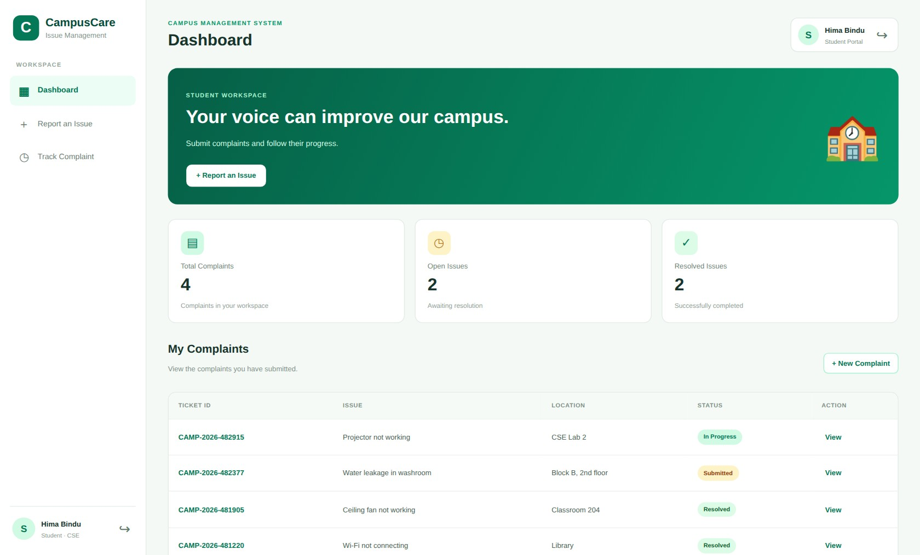
Student Dashboard
WHAT IT DOES
Total, open and resolved counts
My Complaints with live status
Report an Issue and Track Complaint in the menu

Slide 12
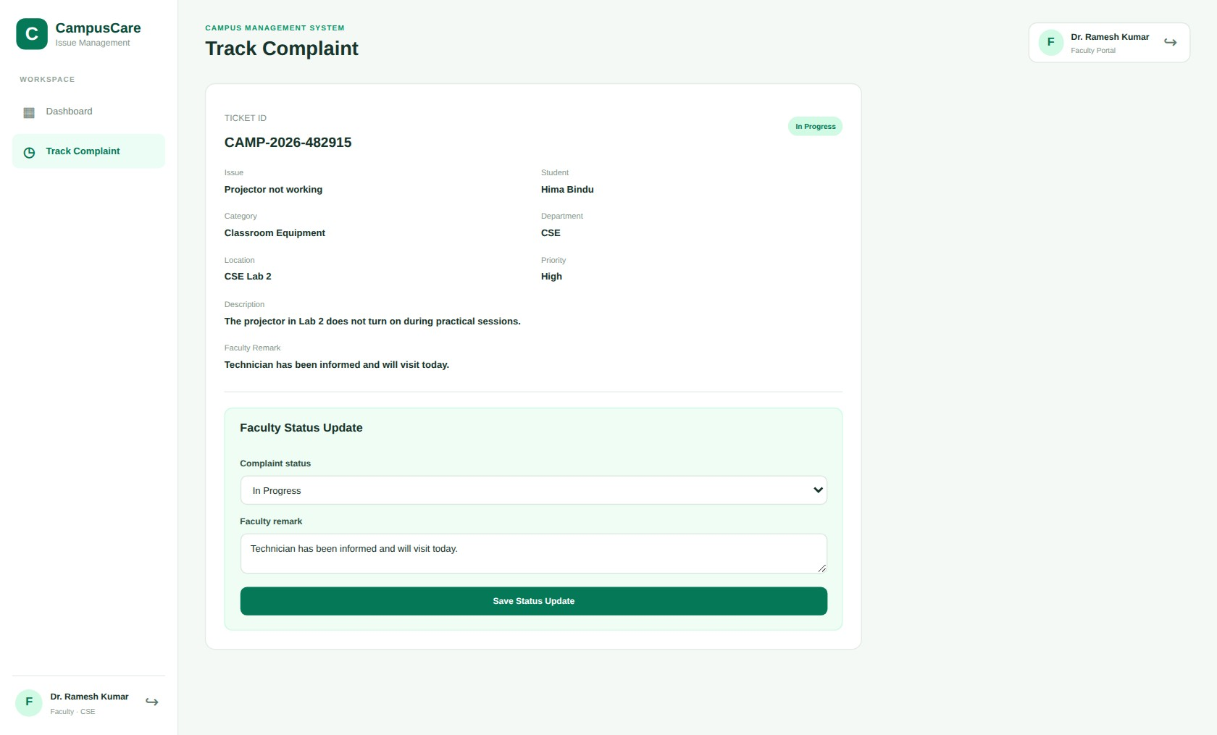
Faculty Status Update
WHAT IT DOES
Open a ticket and read all its details
Set status: Submitted, In Progress, Resolved
The remark is shown to the student

Slide 13

Future Scope & Conclusion
Future Scope
JWT-based secure sessions
Email / SMS status alerts
Photo upload with complaints
Admin analytics dashboard
Conclusion
CampusCare replaces scattered, untracked complaints with one transparent system: students report, faculty resolve, and everyone can see the progress.

Slide 14

Live Demo & Source Code
WEBSITE
campuscare01.vercel.app
BACKEND HEALTH CHECK
campuscare01.onrender.com/api/health
DATABASE (SUPABASE)
supabase.com/dashboard
GITHUB
Scan to open the website
github.com/bhuvana418/CampusCare01

Slide 15
Thank You
Any questions?

